Slide 1

Science-Fiction Author’s Handbook
A Scientific Analysis to Create Masterpieces
Oindrila Sen(Mar-2019 cohort)

Slide 2
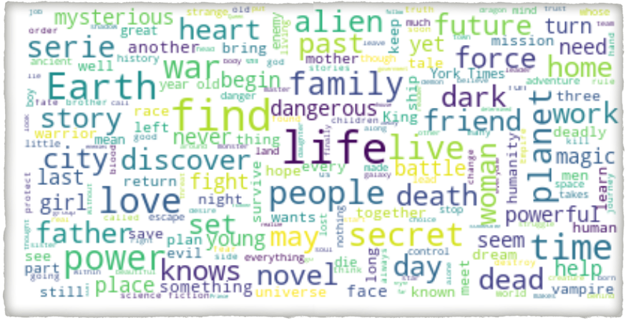
What are sci-fi books about?

Slide 3
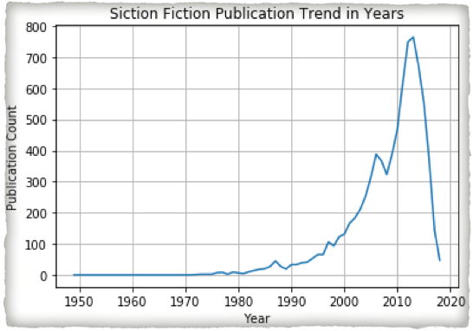
Science Fiction Publication Trends
Science Fiction - The genre of 21st Century

Slide 4
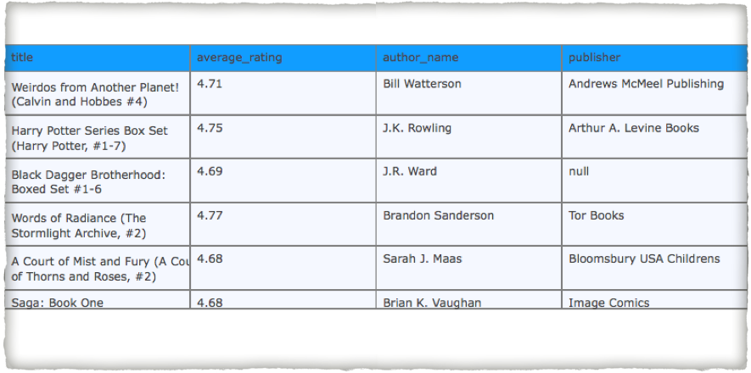
Must-Reads Fantasy Books
Get your inspiration

Slide 5
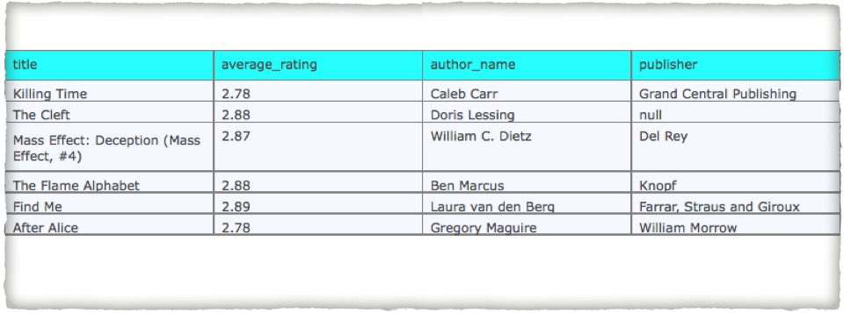
Least Popular Fantasy Books
Read to find out what went wrong!

Slide 6
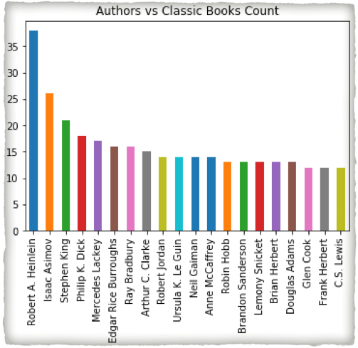
Read/Follow the Master
The authors who created classics in Science Fiction World

Slide 7
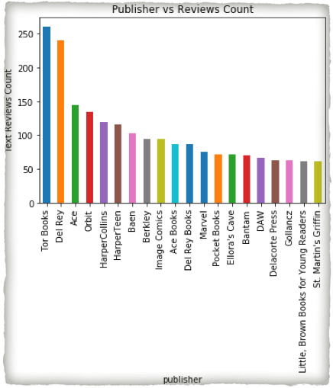
Pick the Right Publisher
Tor Books and Del Rey published some of the best Science-Fiction Books

Slide 8
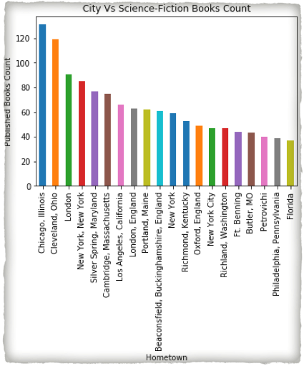
Pick the Right City
Chicago and Cleveland nurtures talents in Sci-Fi/Fantasy

Slide 9
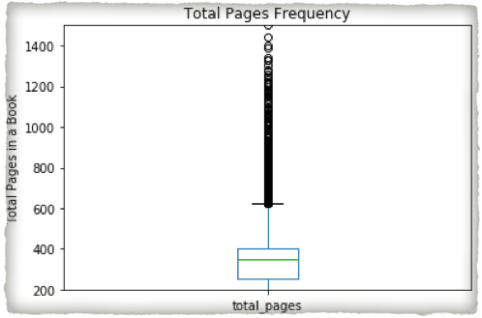
How many pages makes the perfect Novel?
Somewhere between 200-300 looks perfect

Slide 10
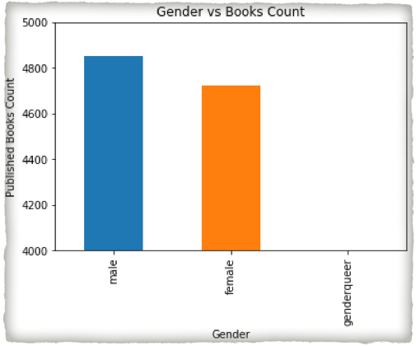
Does Gender Plays a Role?
Male outnumber the Female authors in Sci-Fi Genre

Slide 11
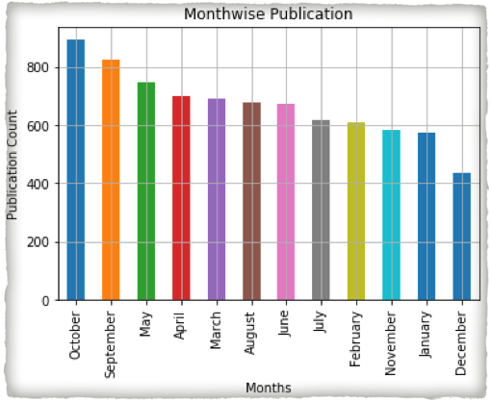
Which Month is Best for Publishing?
Any month is a good time. But October has seen the most publications and December is the slow month

Slide 12
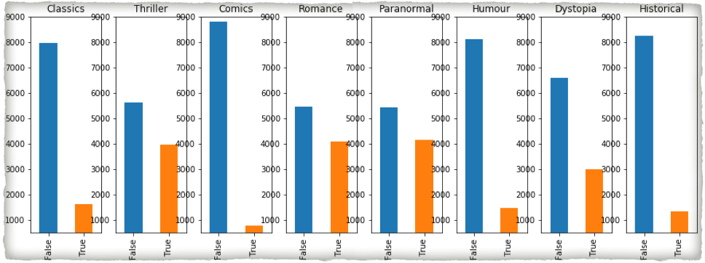
What’s your type?
Thriller, Romance and Paranormal are popular choices.
Fantasy Comics is the least explored zone

Slide 13

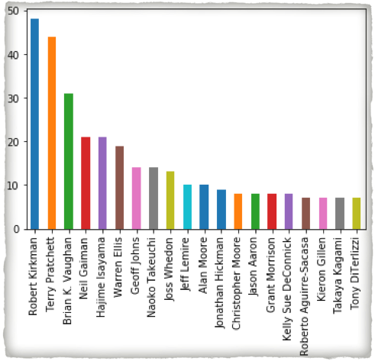



Fantasy Comics Writers

Slide 14
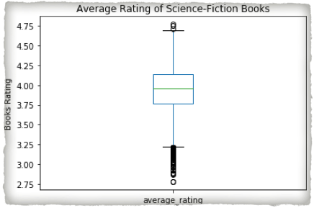
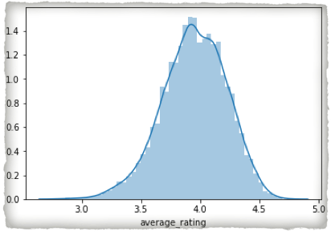
What’s the Mean Rating?

Slide 15
Steps followed for Analysis
Just so if you want to know…
Collect Books and Authors Data from Goodreads
Clean the Data and Extract new features
Add Visuals to Analyze Data
Fit Machine Learning Algorithms to predict rating of a book
Compare Results to pick the best suited Algorithm

Slide 16
Geres Explored So Far
science fiction
science-fiction-fantasy
science-fiction-romance
Apocalyptic
Space
Dystopia
Aliens
Fantasy

Slide 17
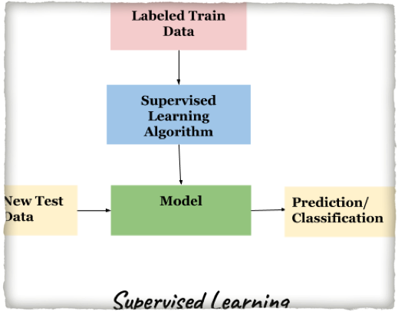
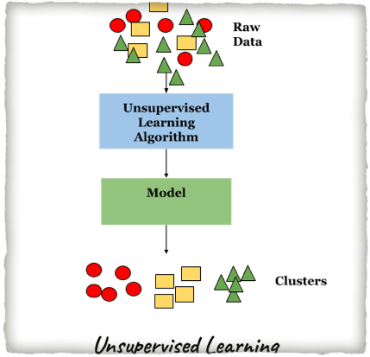
Supervised or Unsupervised?
Used Labeled Ratings of Books for Prediction.
Hence, Supervised Learning

Slide 18

Regression or Classification?
Regression
———————
Output is a Continuous value
Classification
———————
Output is a Category value
Predicted Average Rating of Books which is a Continuous variable.
Hence, Regression

Slide 19
ML Algorithms Used
Linear Regression using Stats Model
Linear Regression using Scikit-Learn
Decision Tree
Random Forest
Support Vector Regressor(SVR)

Slide 20
Compare ML Algorithms Results
Model | R2 Score | Mean Absolute Error | Mean Squared Error | Root Mean Squared Error
Sklearn Linear Regression Model | -0.100 | 0.218 | 0.079 | 0.28
Decision Tree | -0.300 | 0.235 | 0.0932 | 0.30
Random Forest Model | 0.343 | 0.169 | 0.047 | 0.217
Support Vector ReRegressor | 0.240 | 0.179 | 0.054 | 0.233
OLS Stats Model | 0.272

Slide 21
Thank You!
Willing to learn More?
Please check here:
The Github Location

